Slide 1



faculty of education in jagodina, University of kragujevac, serbia

Slide 2

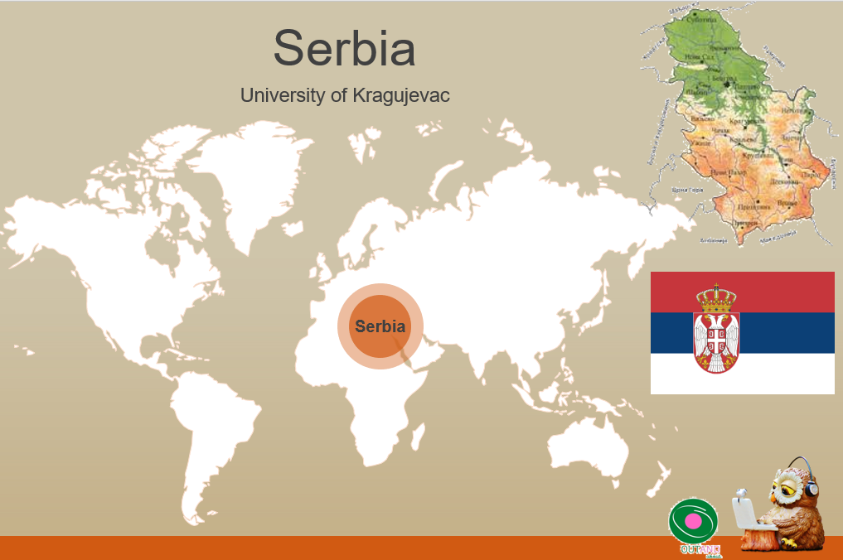
Out and about
Portfolio Presentation

Slide 3
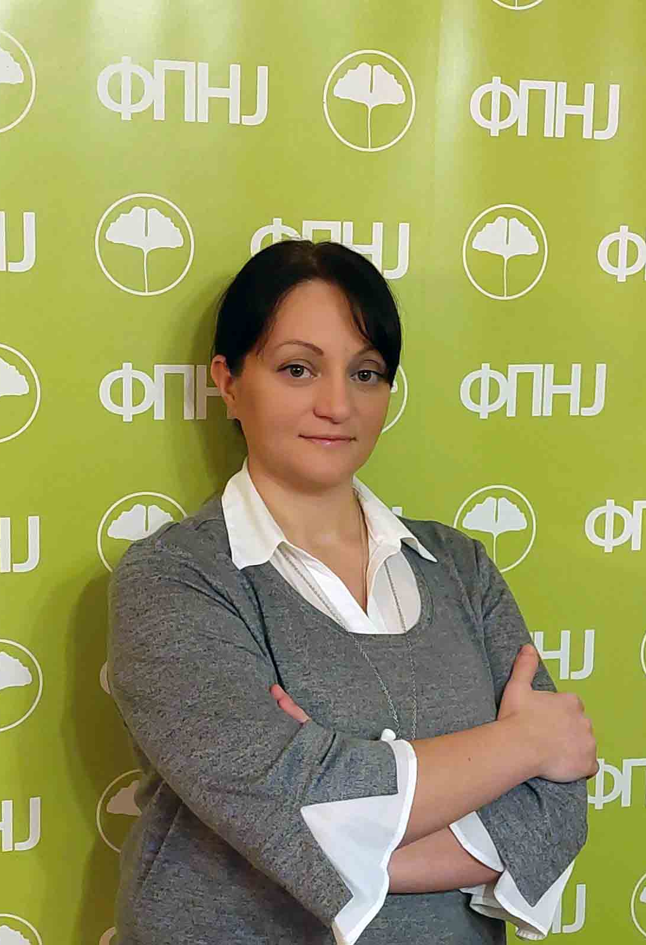
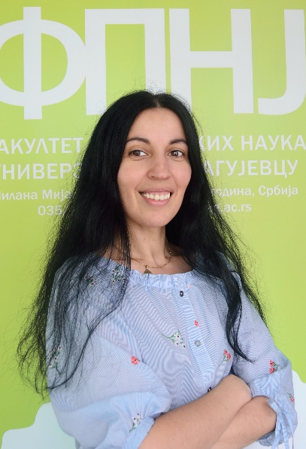
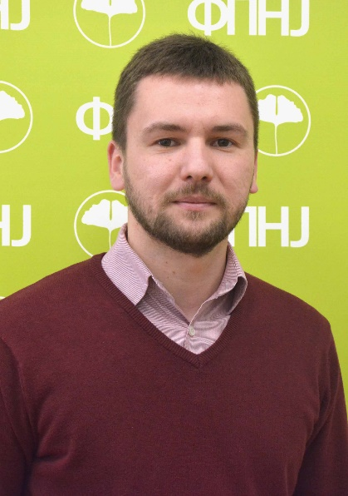
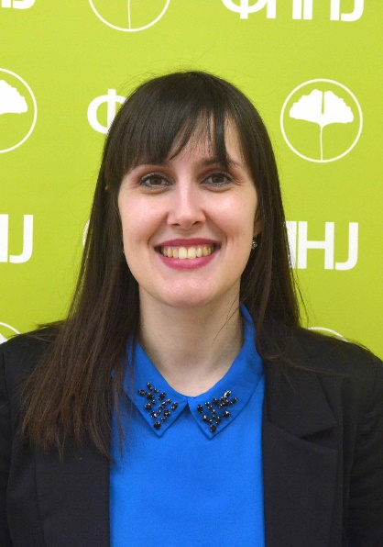
Team Presentation, Faculty of Education
Team for promotion and popularization science and STEAM teaching
Name Here
Name Here
PhD Olivera Cekić-Jovanović
Associate Professor
PhD Aleksandra Mihajlović
Associate Professor
Milan Milikić, MA
Assistant
PhD Marija Stanojevic Veselinovic Assistant Professor
Methodology of Teaching
Science and Social studies
Methodology of Teaching
Mathematics
Methodology of Teaching
Mathematics
Methodology of Teaching
German

Slide 4
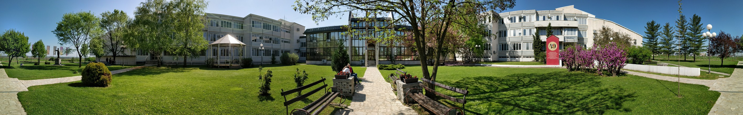
University in Kragujevac

Slide 5
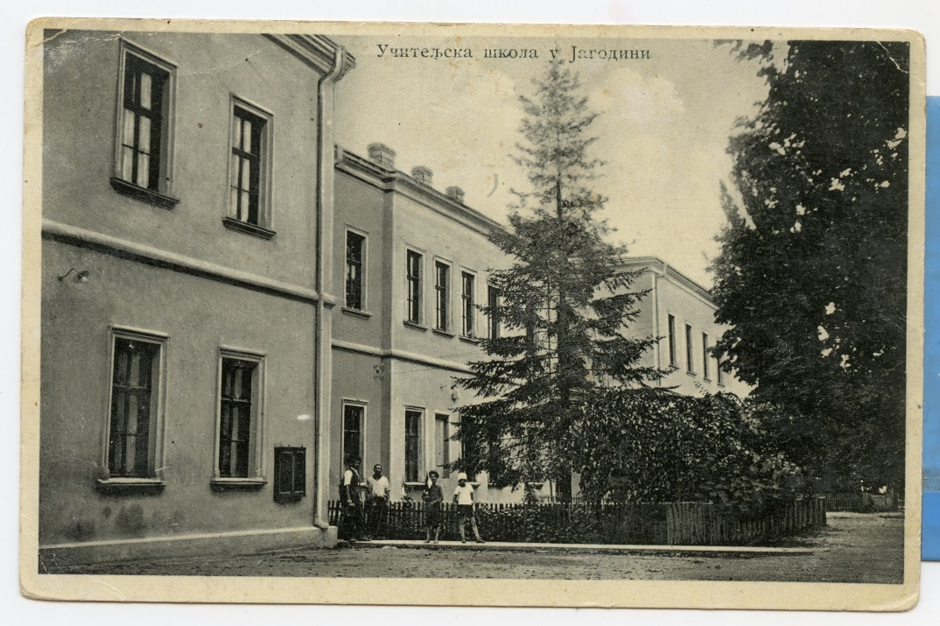
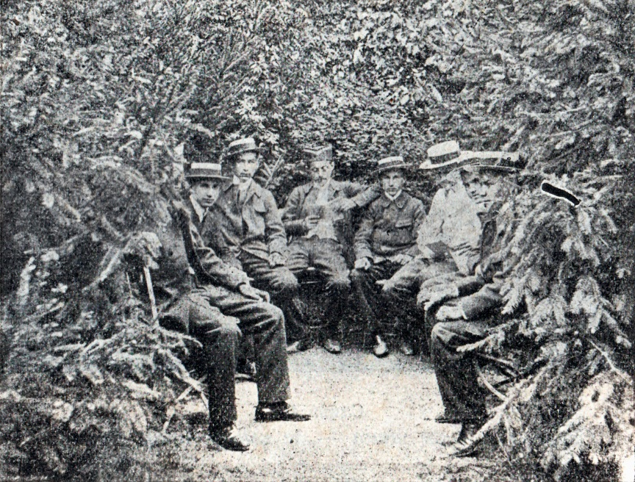
Tradition: more than 120 YEARS of teacher education

Slide 6
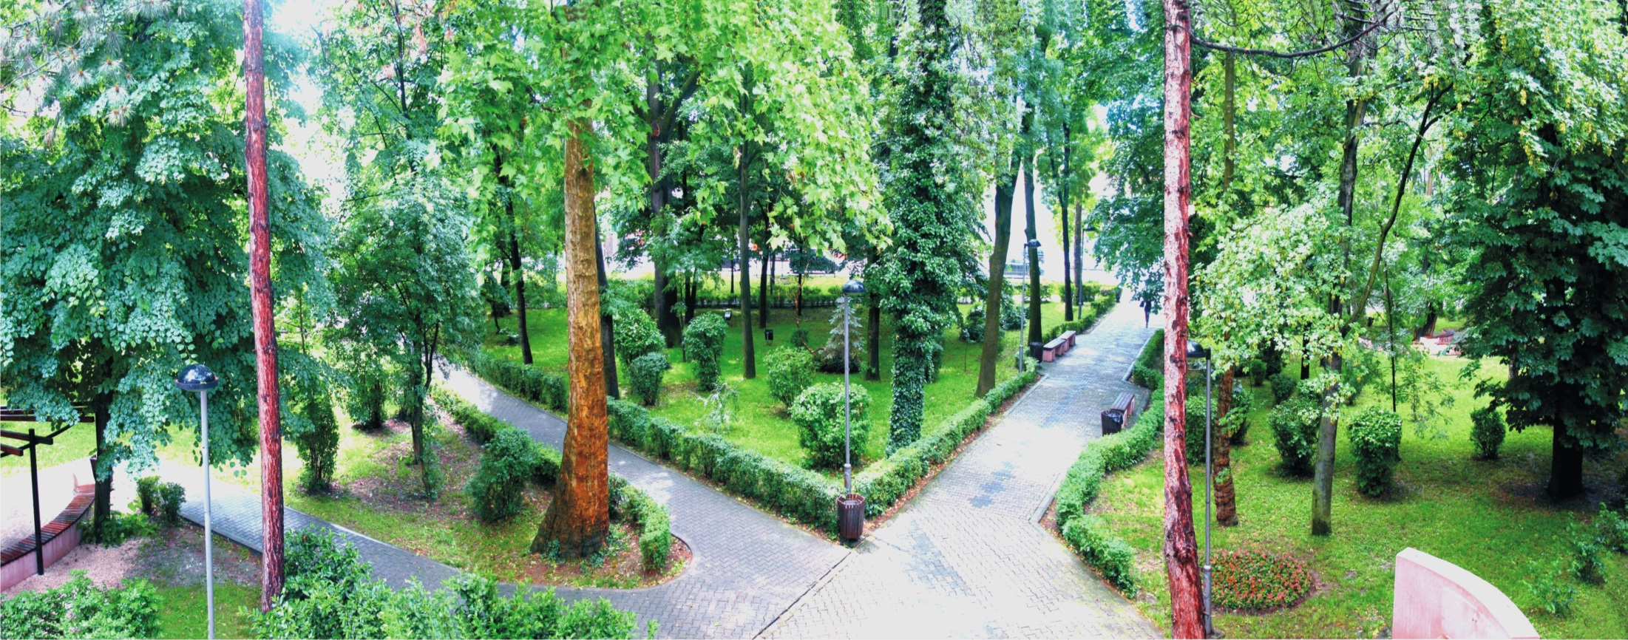

Slide 7
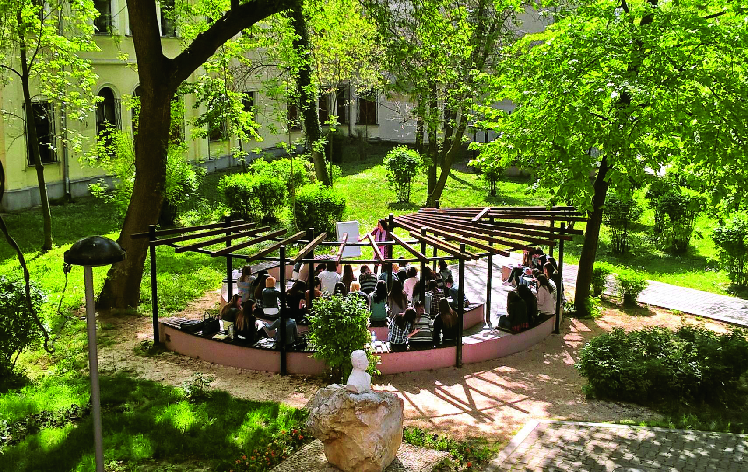

Slide 8
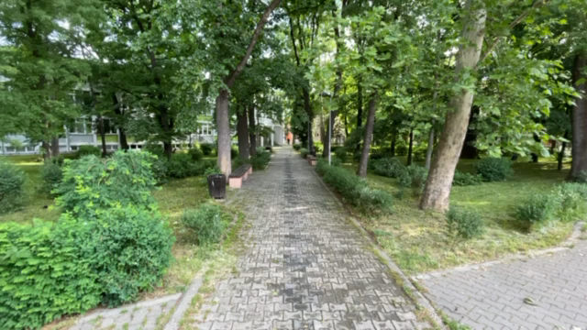
Faculty

Slide 9
Study Programmes
Class Teacher Education
Preschool Teacher Education
Boarding-School Teacher Education
Class Teacher Education
Preschool Teacher Education
Boarding-School Teacher Education
Subject Teacher Education
Leadership in Education
Education Policy
https://pefja.kg.ac.rs/english/
BA studies
MA studies
Methodology of teaching:
Physical Education
Serbian Language and Literature
Science
PhD studies

Slide 10
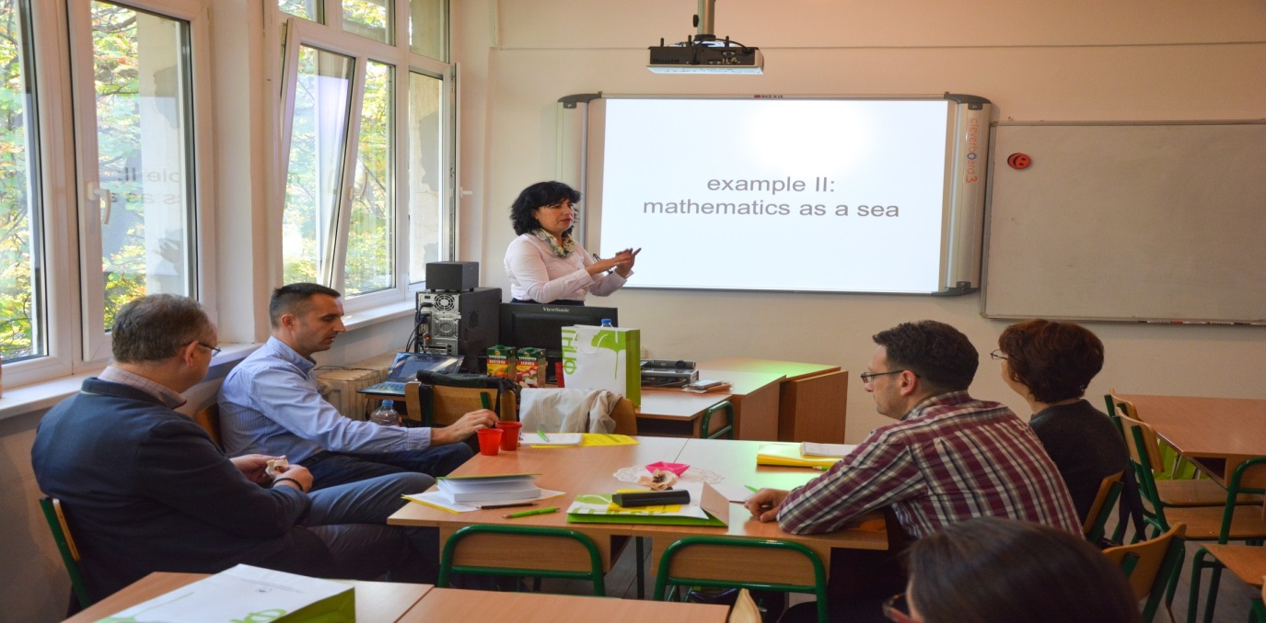
International cooperation
Eötvös József Főiskola Baja, University of Helsinki (Finland), University of Nicosia (Cyprus), University of Innsbruck (Austria), University of Marburg (Germany), Universities of Ljubljana and Koper (Slovenia) etc.

Slide 11
International projects
STEP – Finnish-Serbian Teacher Education Project (2004–2006)
TEMPUS Curriculum Reform in Teacher Education (2006–2009)
Curriculum Development: Improvement of Practice Teaching and Research (2007–2008)
Increased Responsibility in Ecology and Human Rights Teaching (2009–2010)
TEMPUS Master Programme for Subject Teachers in Serbia and Montenegro (2010–2013)
TEMPUS Modernizing Teacher Education in a European Perspective (2010–2013)
TEMPUS Developing Human Rights Education at the Heart of Higher Education (2011–2014)
Bilateral projects with Slovenia and Montenegro (20016-2023)
LiMa project with Germany

Slide 12
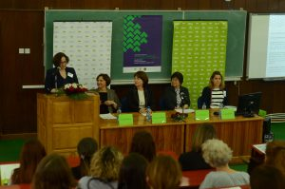
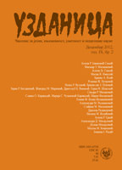
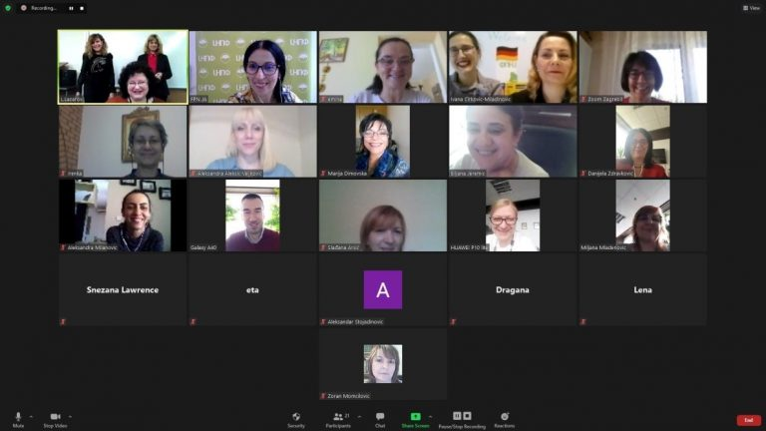
International scientific conferences
Online conferences

Slide 13



Development and Research Centres of the Faculty of Education

Slide 14
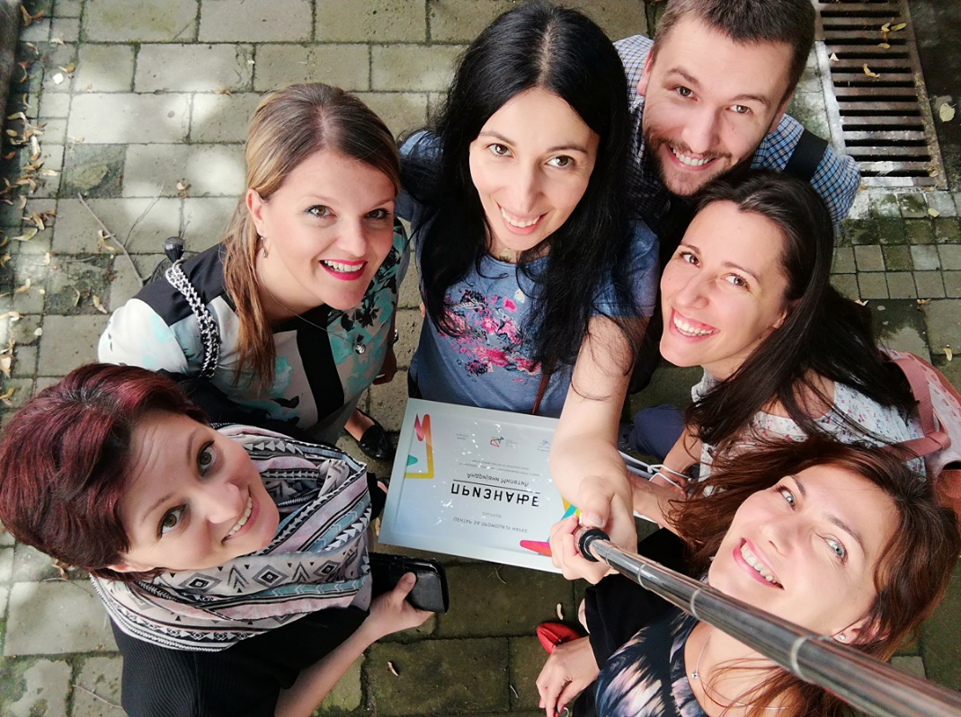
NUM team and the Center for the Promotion of Science

Slide 15
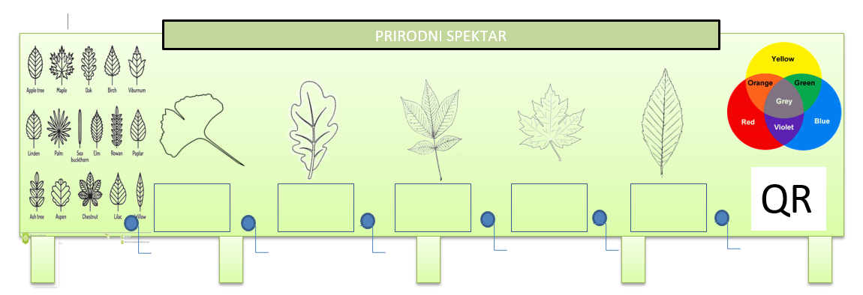
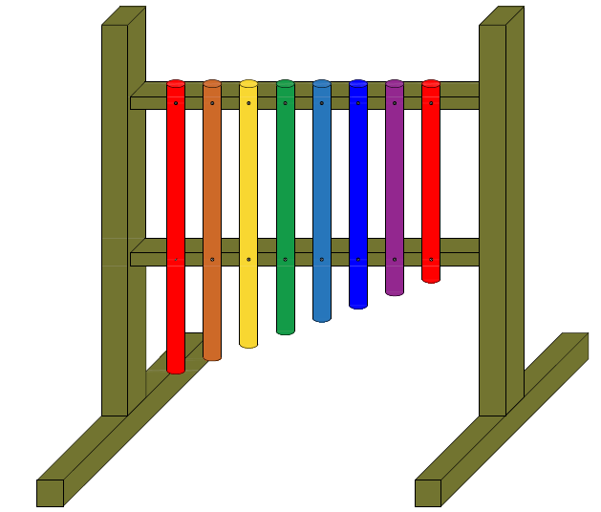
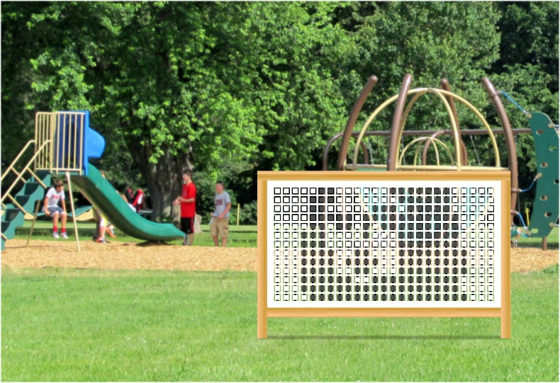
Exhibits for Science Parks
Outdoor Learning
Within the NUM team that is active at the Faculty of Education, several original conceptual solutions of exhibits for science parks have been designed. These exhibits were awarded at the competitions of the Republic Center for the Promotion of Science and are located in science parks throughout Serbia.
Natural spectrum
Interactive pixel wall
Music through science and art

Slide 16
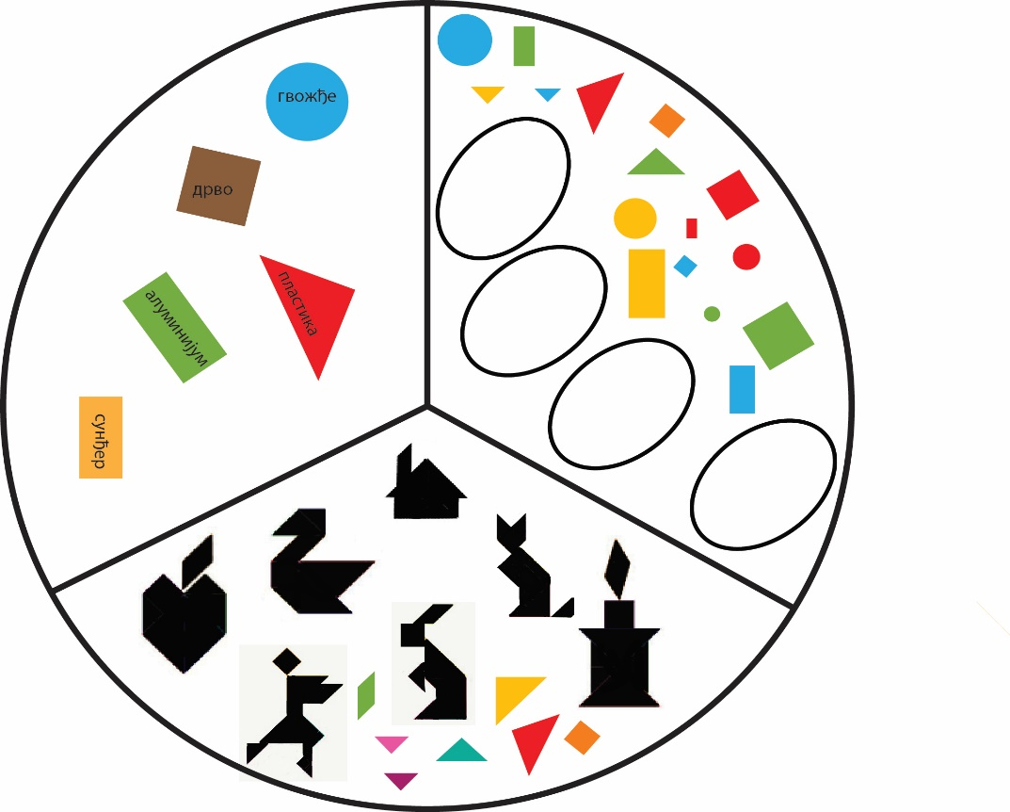
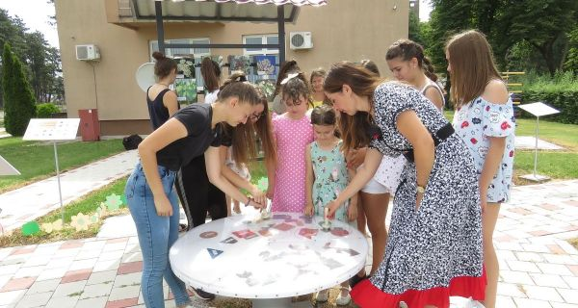

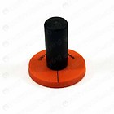
NUM magnetic table

Slide 17
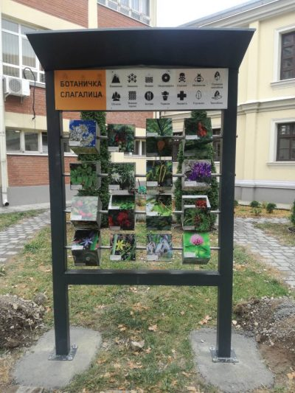
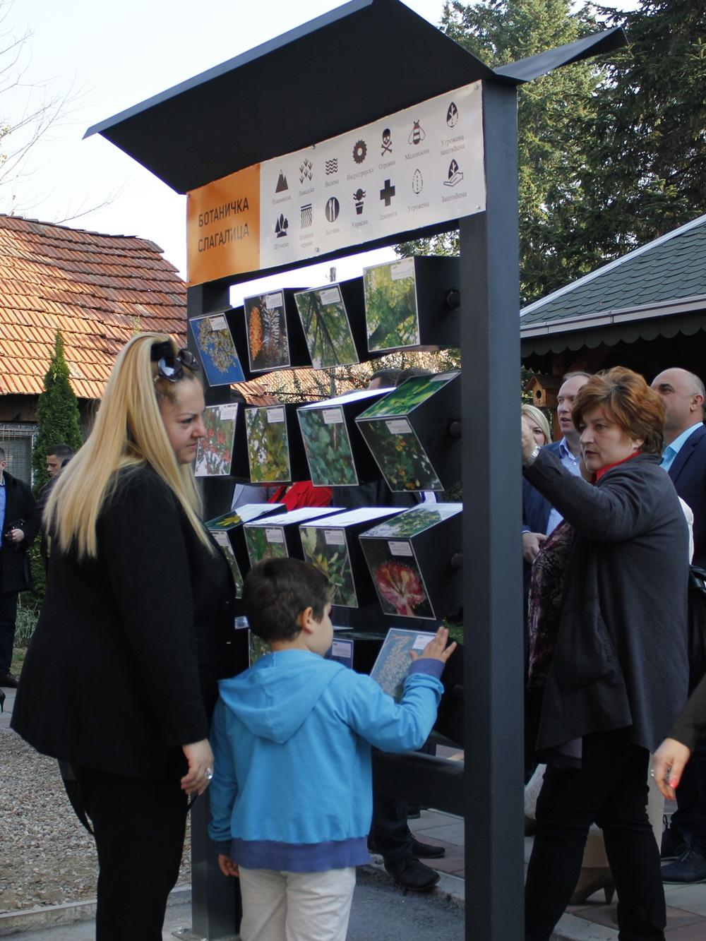
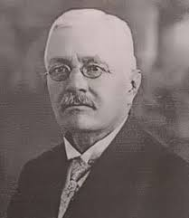
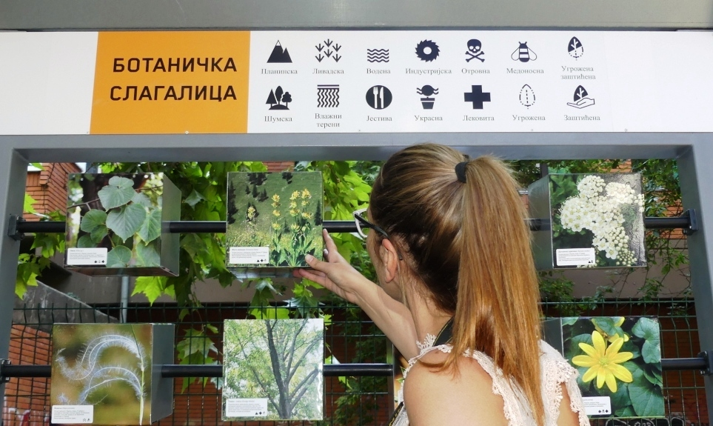
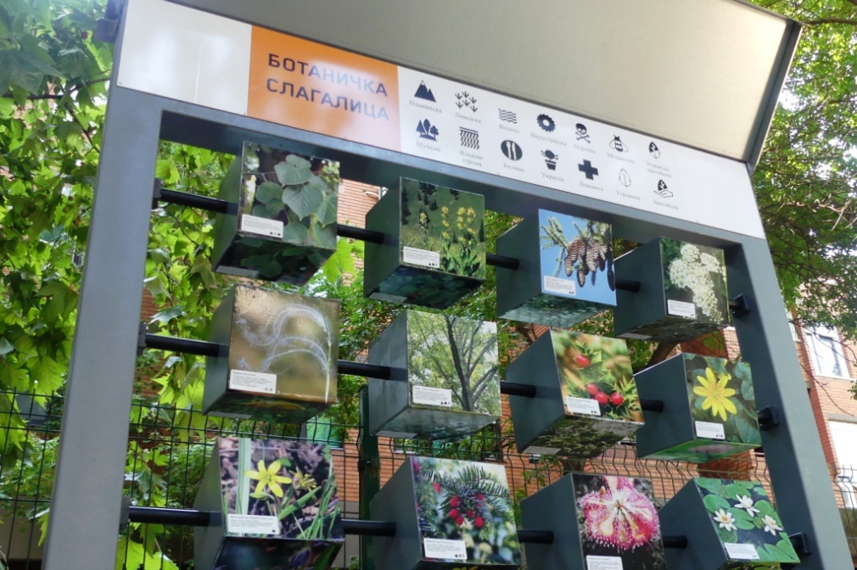
Botanical puzzle “Sreten adzic”

Slide 18
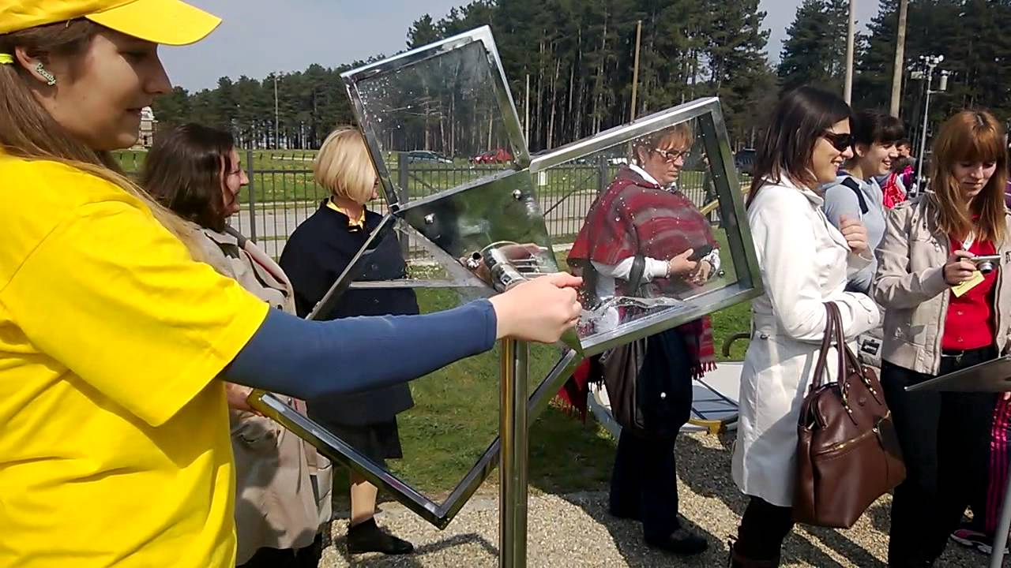
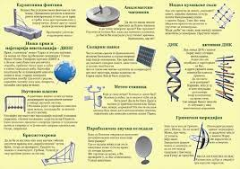
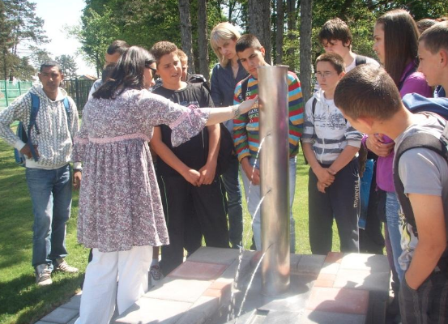
Teaching in science parks

Slide 19
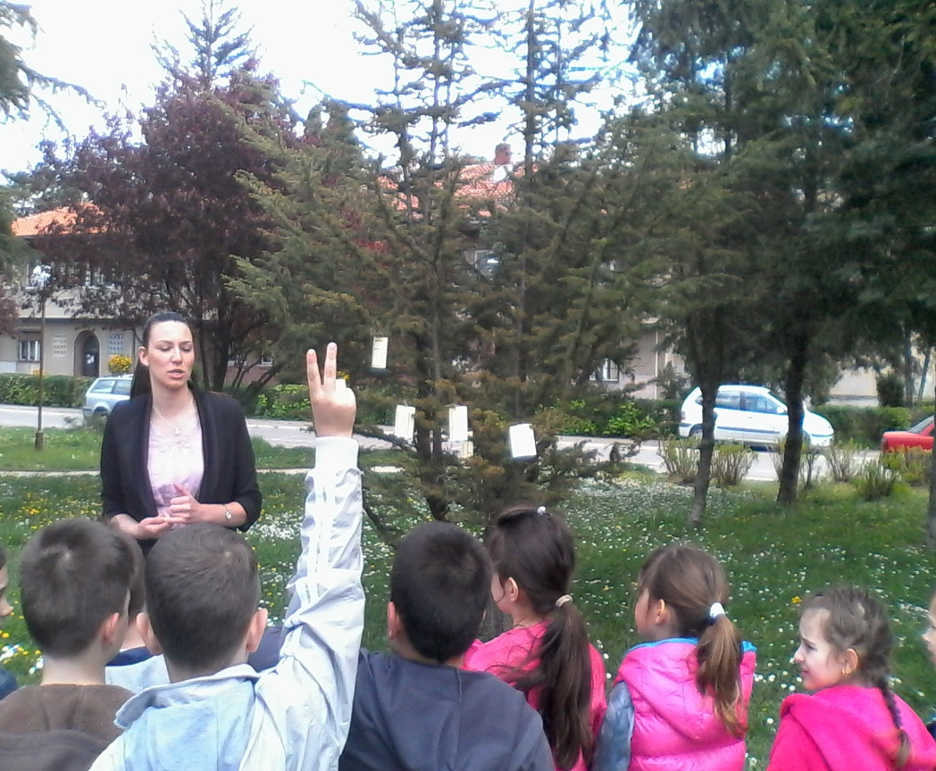
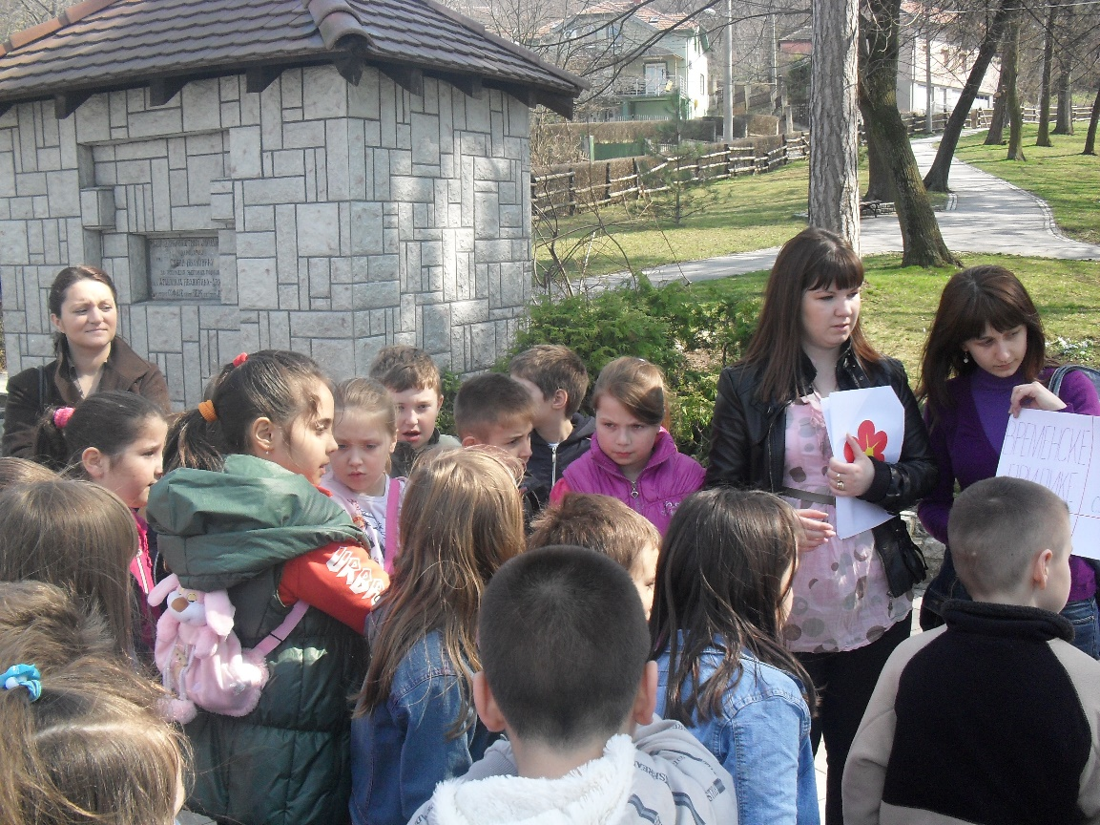
Teaching at the Zoo in jagodina

Slide 20
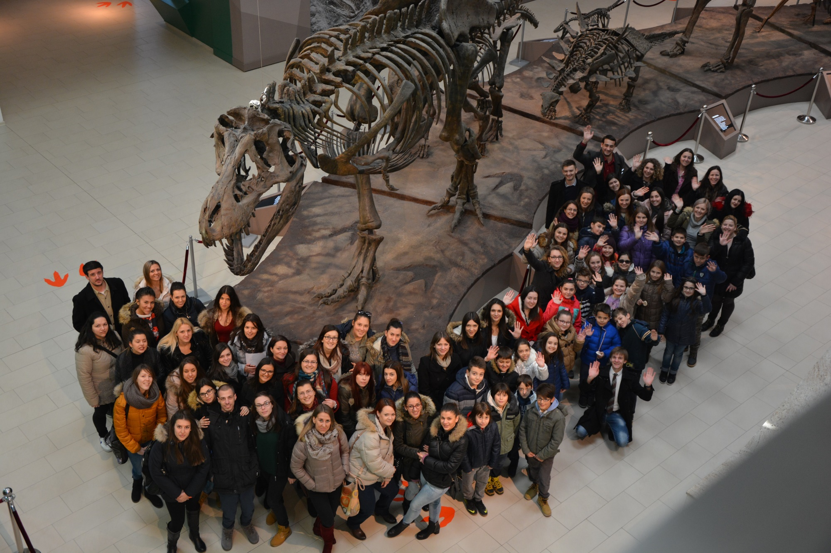
Our students - Realization of classes in the museum

Slide 21
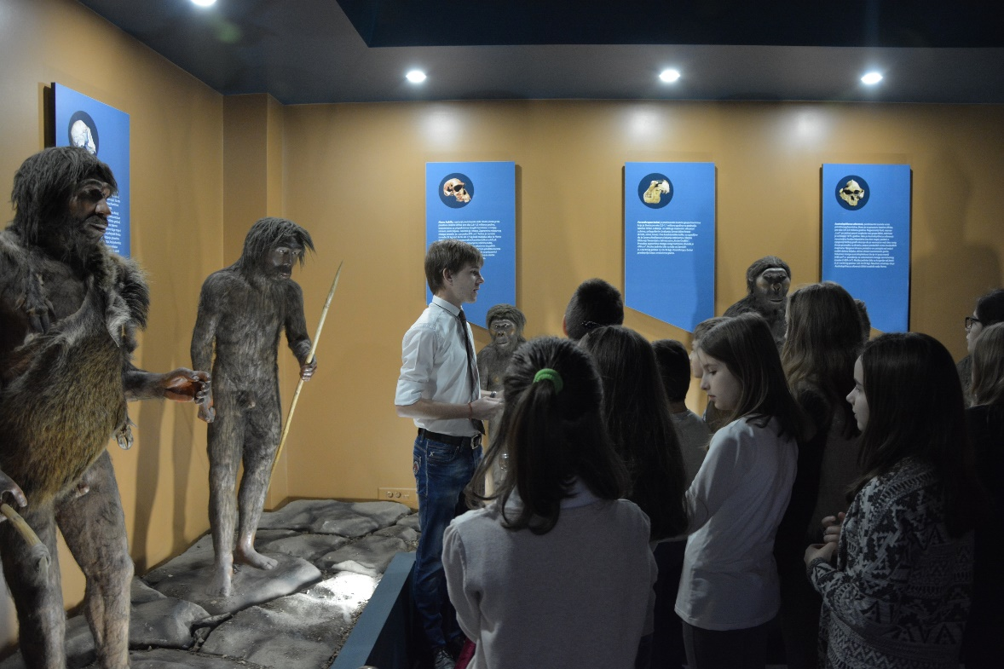
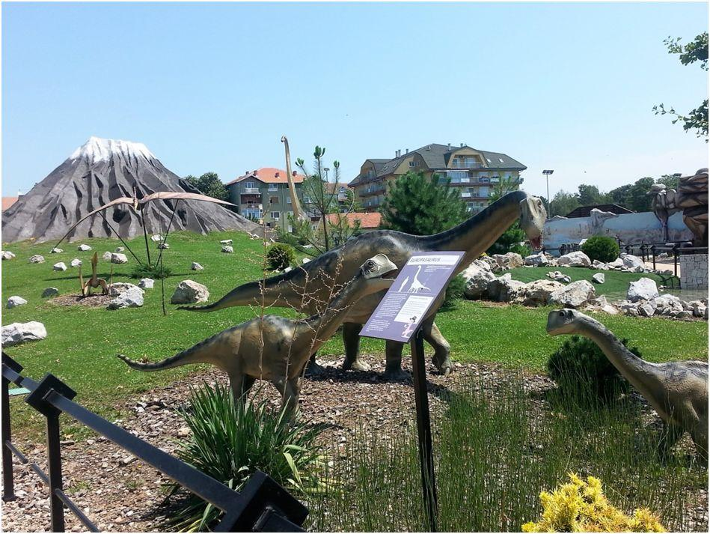
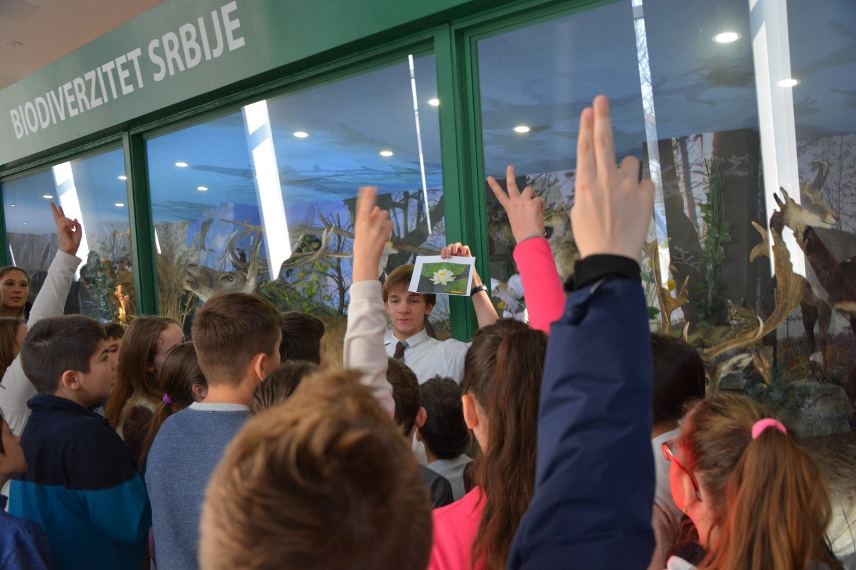
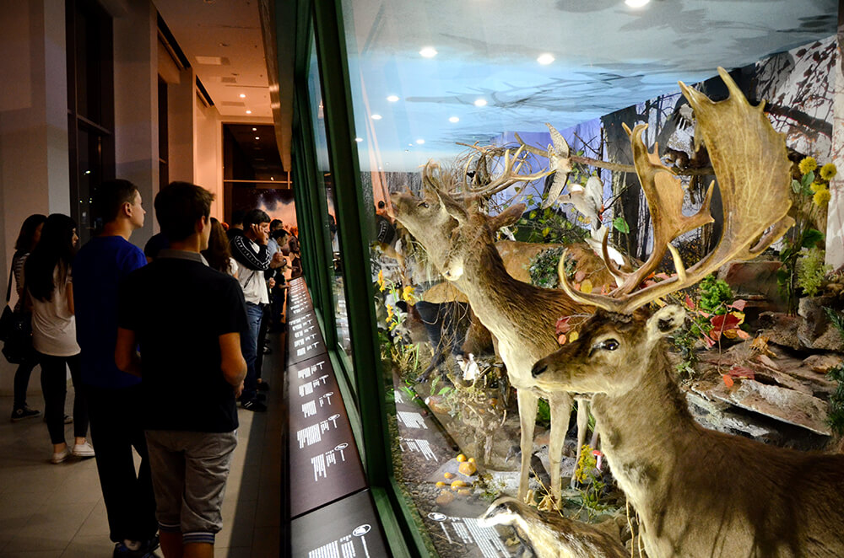
Teaching at the Natural History Museum in Svilajnac

Slide 22
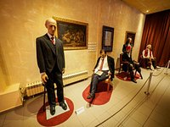
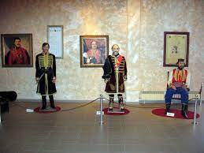
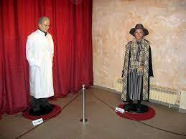
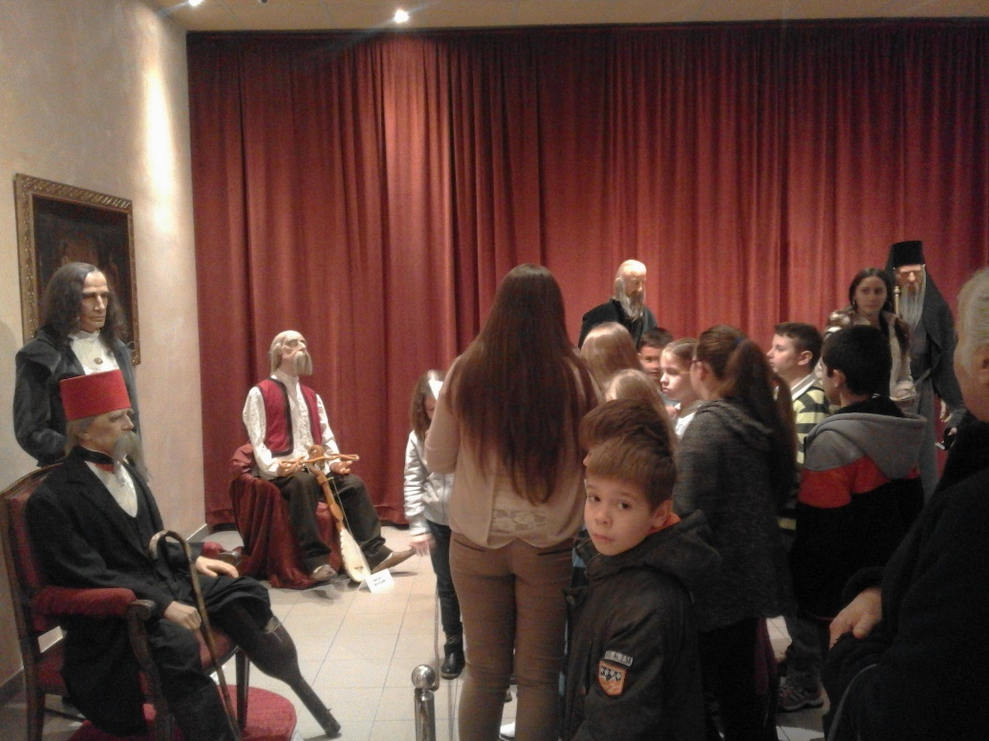
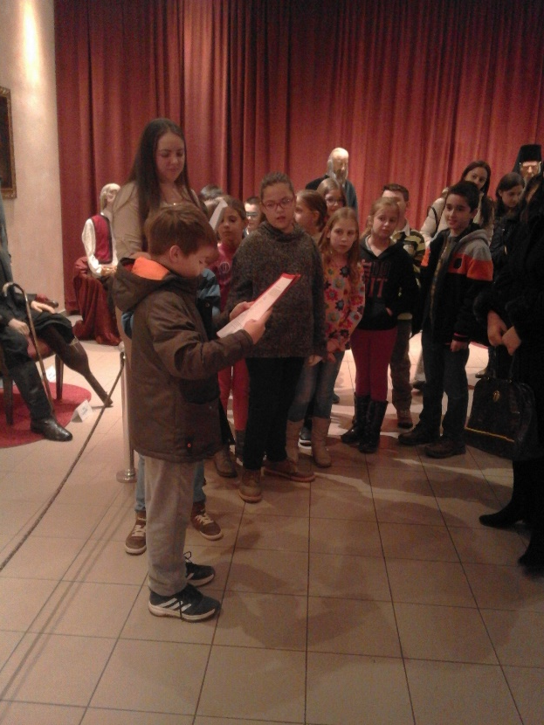
Teaching at the Museum of Wax Figures and the Homeland Museum

Slide 23
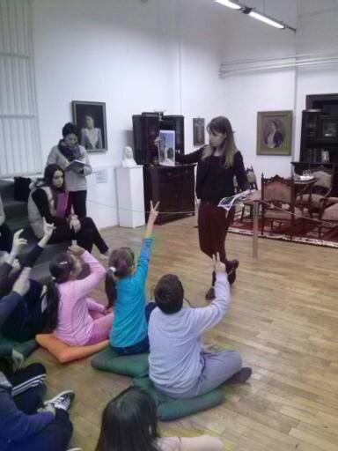
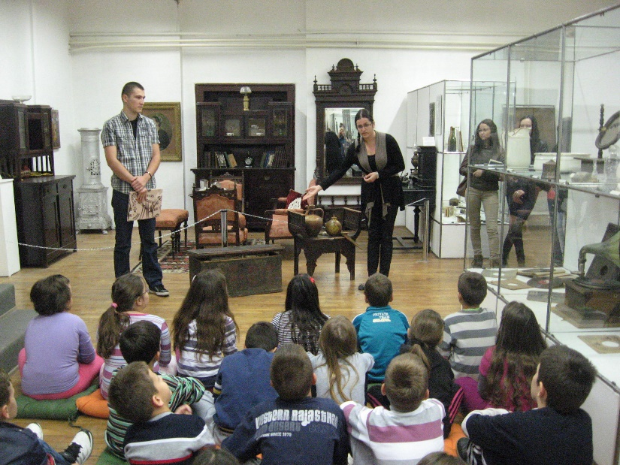
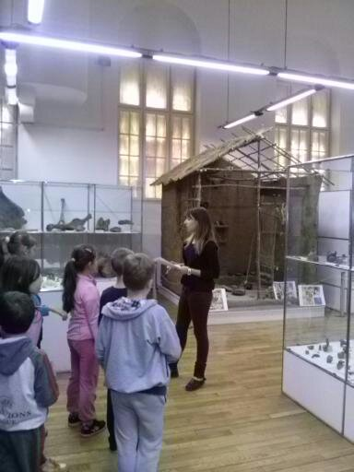
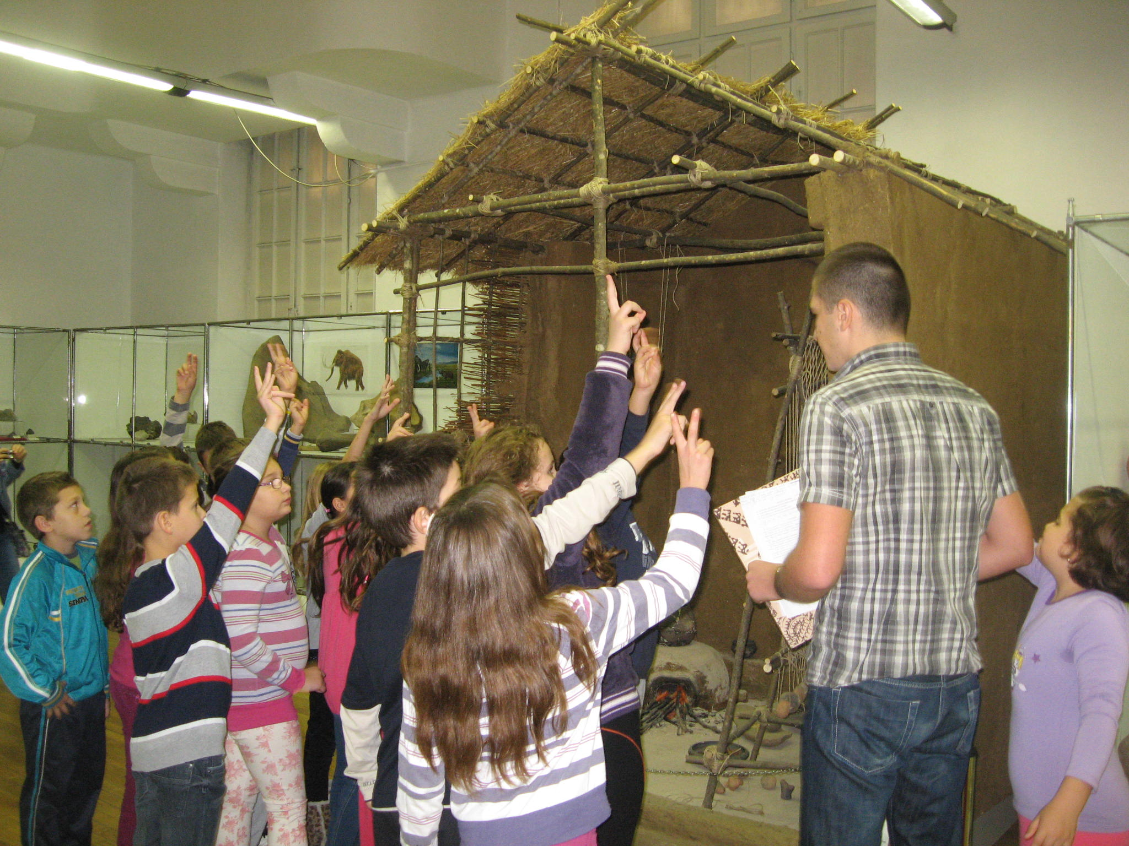

Slide 24
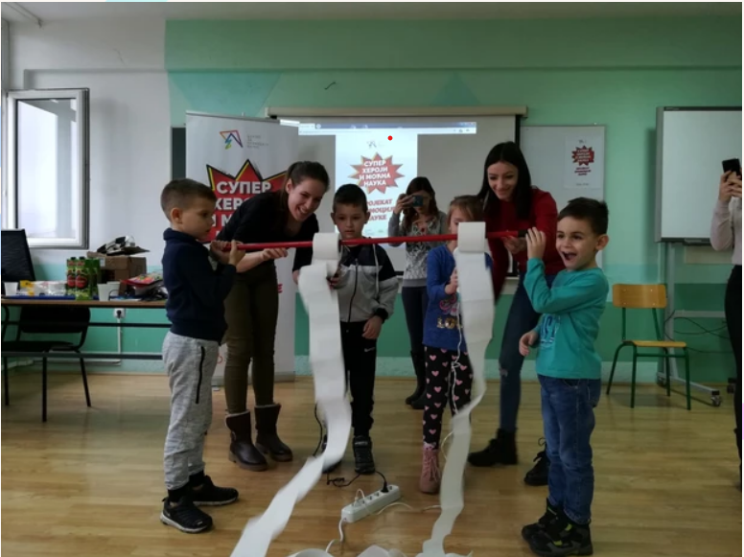


Science promotion projects
Superheroes and powerful science. It has been realized since 2018 until now.

Slide 25
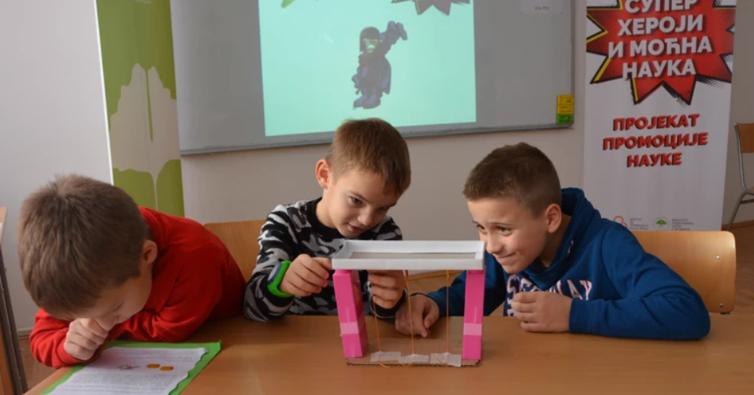
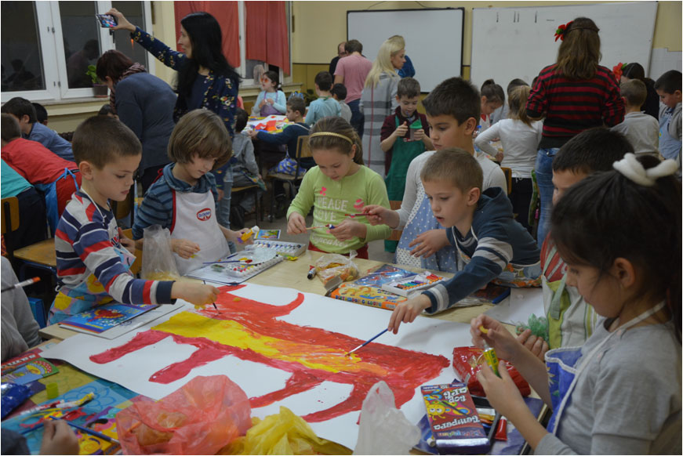
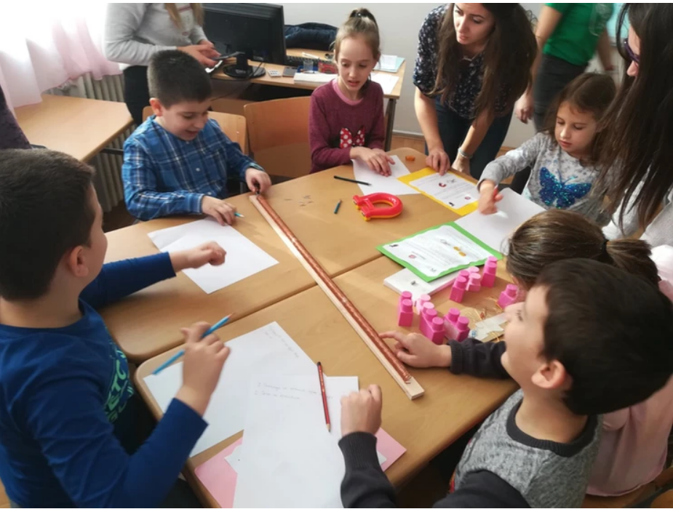

Superhero site
https://ocekicjovanovic.wixsite.com/superherojifpnj/galerija-fotografija

Slide 26

Proposed plan for activity Teacher Training in Serbia
First day
Theoretical approach to environmental and outdoor teaching and learning
Examples of good practice of outdoor learning
Creating a lesson plan for outdoor learning
Analysis of a finished scenario of outdoor learning
Task for group work
Second day
Report on the topic
Work in teams on a lesson plan
Presentation of the lesson plan
Reflection
Voting
Third day
Realization
Reflection
Future plans

Slide 27
Thank you for your attention!
See you soon in Serbia!
PhD Olivera Cekić-Jovanović
Associate Professor
PhD Marija Stanojevic Veselinovic Assistant Professor
o.cekicjovanovic@gmail.com
majastanojevic2@gmail.com

