Slide 1


Slide 3
PURPOSE OF THE EXERCISE
The aim of this exercise is to develop a new mobile app utilizing App Inventor, which will serve as a multiple-choice quiz. This app will be designed to store its questions using Google Sheets for mobile accessibility.

Slide 4
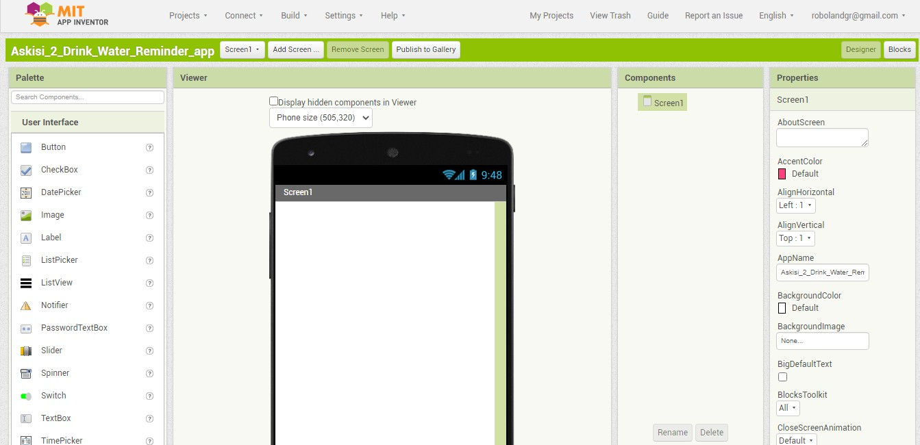
OPENING THE APPLICATION
Initially, upon launching the application, we encounter the following menu

Slide 5
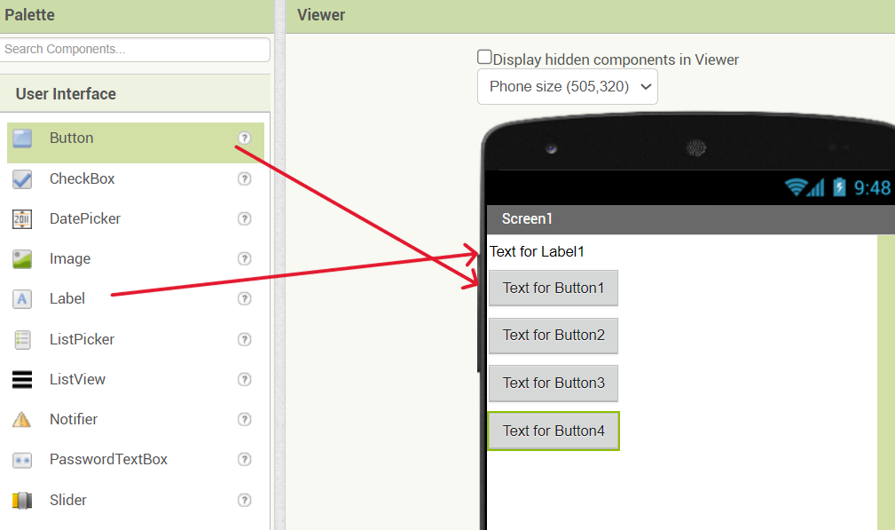
CREATE FIRST SCREEN
In the User Interface, drag and drop one label and four buttons. The text label will be used to display the questions, while the buttons will serve as answer choices.

Slide 6
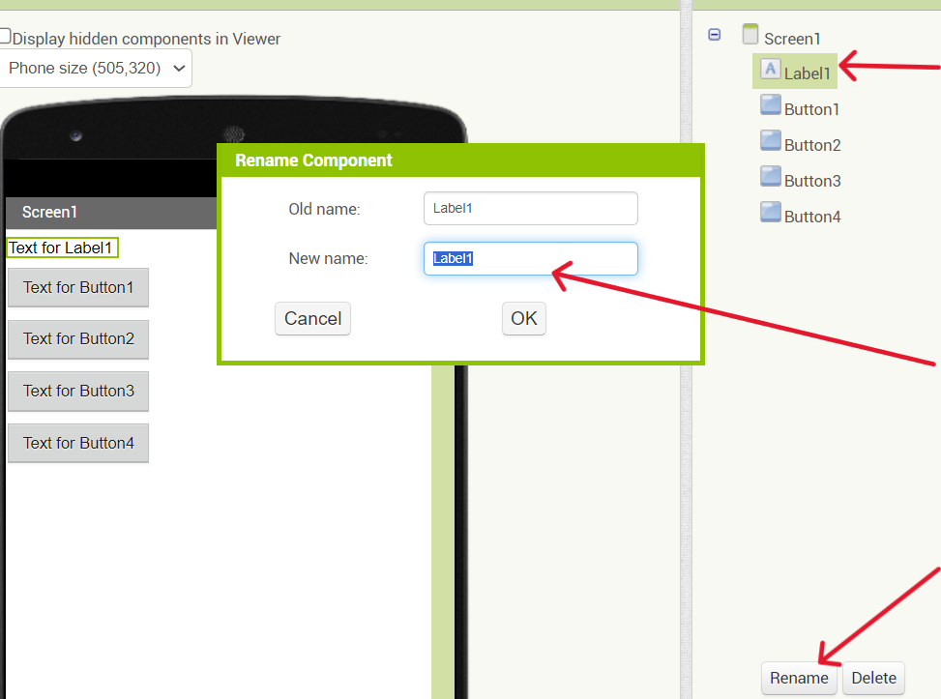
RENAME LABEL AND BUTTONS
Step 1
To rename any component used in the interface, follow these three simple steps: Step Step 1: Click on the component.
Step 2: Click the "Rename" option.
Step 3: Enter the desired name and click "OK."
Step 3
Step 2

Slide 7
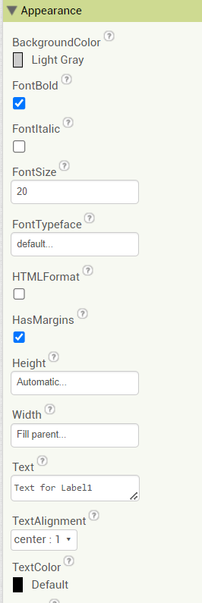
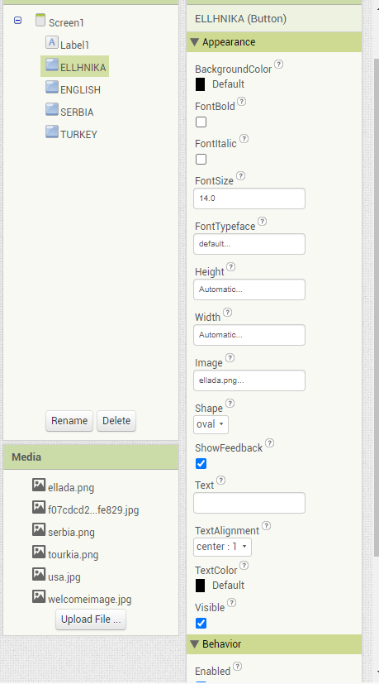
LAYOUT CUSTOMIZATION
These are the modifications made to the label.
To add images to the buttons, you should download a photo of your choice, such as flags of different countries. Then, follow these steps to insert them onto the buttons:
Click on the button where you want to add the image.
Select the "Image" option.
Choose the downloaded photo and press "Upload."

Slide 8

FINAL LAYOUT OF THE FIRST SCREEN
When you open our app, the initial screen you'll encounter is the selection of flags. By tapping on any flag, you will enter the quiz associated with the corresponding language.

Slide 9

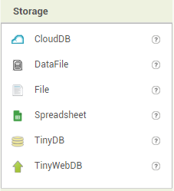
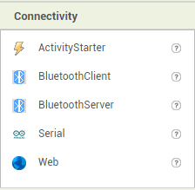
ADD ANOTHER SCREEN
To create an additional screen, click on the middle button, enter the desired screen name, and then press "OK."
For this step, drag and drop the components again, but this time you'll need to include the "Web" and "TinyDB" components.
This TinyDB component is utilized to transfer variables from one screen to another within our app.
This component is used to store the link of our Google Sheets, which serves as the source for our quiz data.

Slide 10
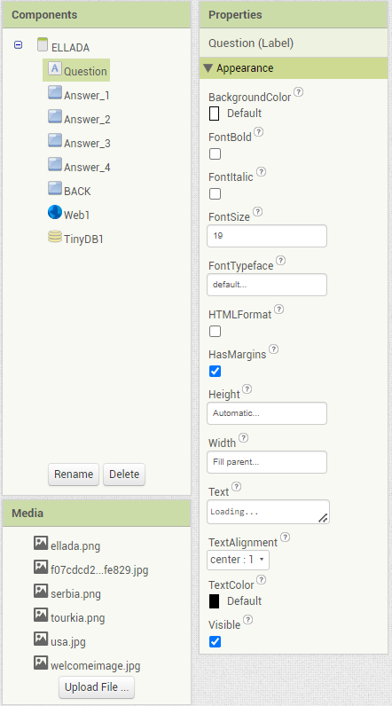
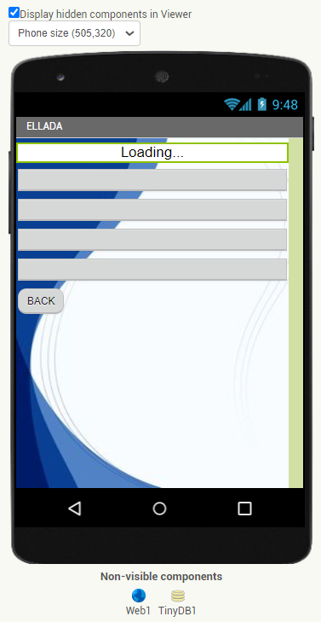
COUNTRY SCREEN
This is the screen that opens when you click on any flag icon.
To make your label appear as shown, you need to make the changes indicated in the "Appearance" settings.

Slide 11
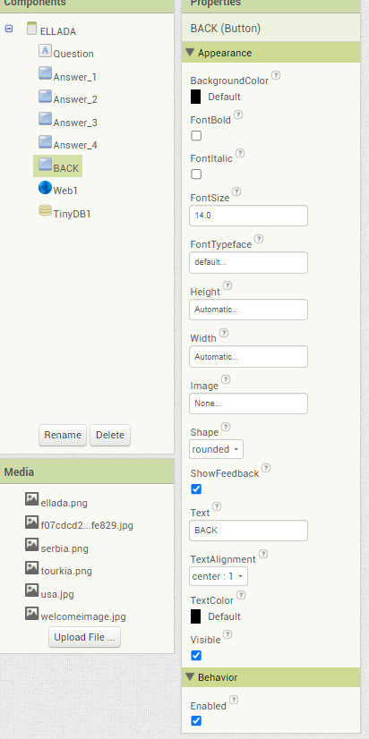
BACK BUTTON
To configure the back button, you can make the following changes:
This button will be used to navigate back to the first screen.

Slide 12
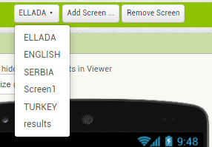
ADD ALL THE COUNTRY SCREENS
Now add three more screens for each country
Name each screen after the name of the country

Slide 13
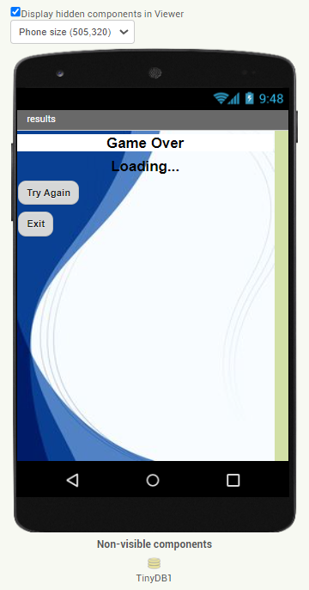
RESULTS SCREEN
For the Result screen Drag and Drop two Labels, two Buttons and TinyDB.
The first label change the text to Gave Over, for the second change it to Loading…
The second Label will display the score of the quiz.
Button one is used to try again the quiz and Button two to exit the application.
The TinyDB tranfers the score from screen to screen.

Slide 14
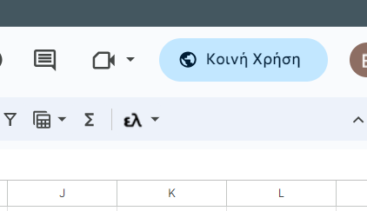
HOW TO GET THE QUESTIONS
We need to incorporate a link that facilitates access to both the questions and answers..
Step 1: Click the "Share" button.
Step 2: Grant access to anyone with the link, and then click "Copy."
After copying the link, it will appear in the following format:
https://docs.google.com/spreadsheets/d/1IKJzsrrn2xXjx9-CJevXq6d96ZYfwSjKAlVs2nOW_GE/edit?usp=sharing
Now, you will replace the portion following the last "/" with the following: export?format=csv
So the link will look like this: https://docs.google.com/spreadsheets/d/1IKJzsrrn2xXjx9-CJevXq6d96ZYfwSjKAlVs2nOW_GE/export?format=csv

Slide 15
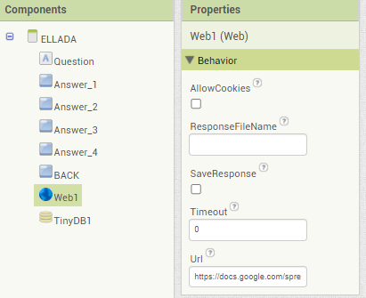
HOW TO USE THE QUESTIONS
Click on "Web1," then paste the link in "Url1." You'll need to repeat this process for all the screens.

Slide 16
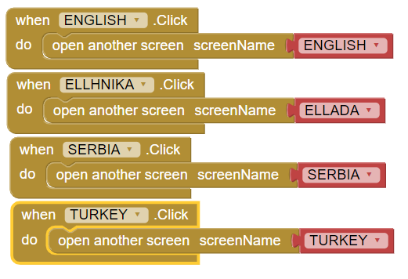
CODING WITH BLOCKS
We have created four buttons, each representing a different country, and when a specific button is pressed, it opens the corresponding country's quiz.

Slide 17
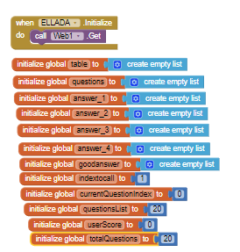
VARIABLE DECLARATION
Before commencing the coding process, it's essential to initialize certain variables.
When the Greece screen initializes, initiate the 'web1' component to fetch the link for Greece's quiz.
This variable is used as a counter. In the code, we increment it after each question.
We set the score to be 0
We set this variable to be equal to the number of questions.

Slide 18
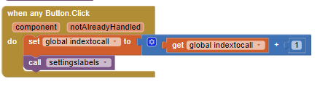
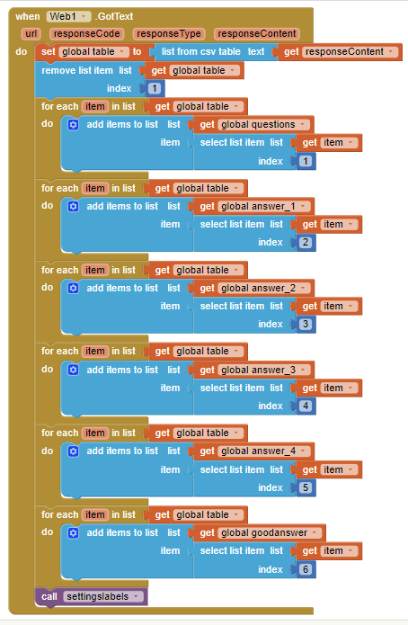

CODE
When we click any button on the screen, we increment the 'intectocall' variable by 1 and invoke the 'settingslabels' function.
When we click the back button it transfers us to the first screen
In MIT App Inventor, when the "Web1" component calls the "Text" block, it retrieves the text response from a web request, which can be used to access and process data from external sources such as web services or APIs.

Slide 19
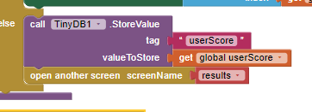
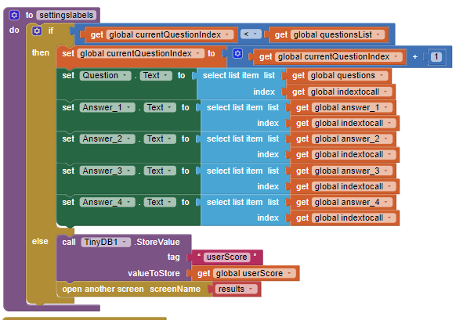
SETTINGSLABELS CODE
Settingslabels is called to set the text on the buttons and the labels
TinyDB1 is employed to transmit the 'score' variable to the results screen.

Slide 20
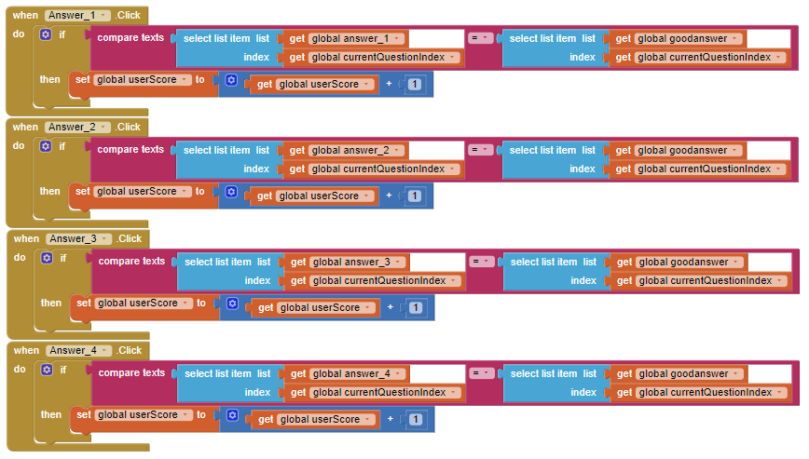
TEST THE ANSWERS
With this conditional statement, if, for example, the button "Answer_1" is pressed, it checks whether the text of the selected answer matches the correct answer. If it's true, then it increments the 'score' by one.

Slide 21


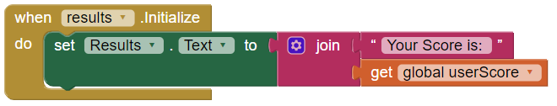
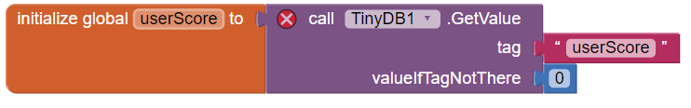
RESULTS CODE
The results screen features two buttons: the "Exit" button, which closes the application, and the "Try Again" button, which resets the first screen for restarting the quiz. Additionally, a label is included on the results screen to display the score when the results screen is initialized.
"Try Again" button, which resets the first screen, allowing the user to start the quiz again.
"Exit" button, which closes the application
label is included on the results screen to display the score when the results screen is initialized.
Declares the variable and retrieves the result from the database.

Slide 22
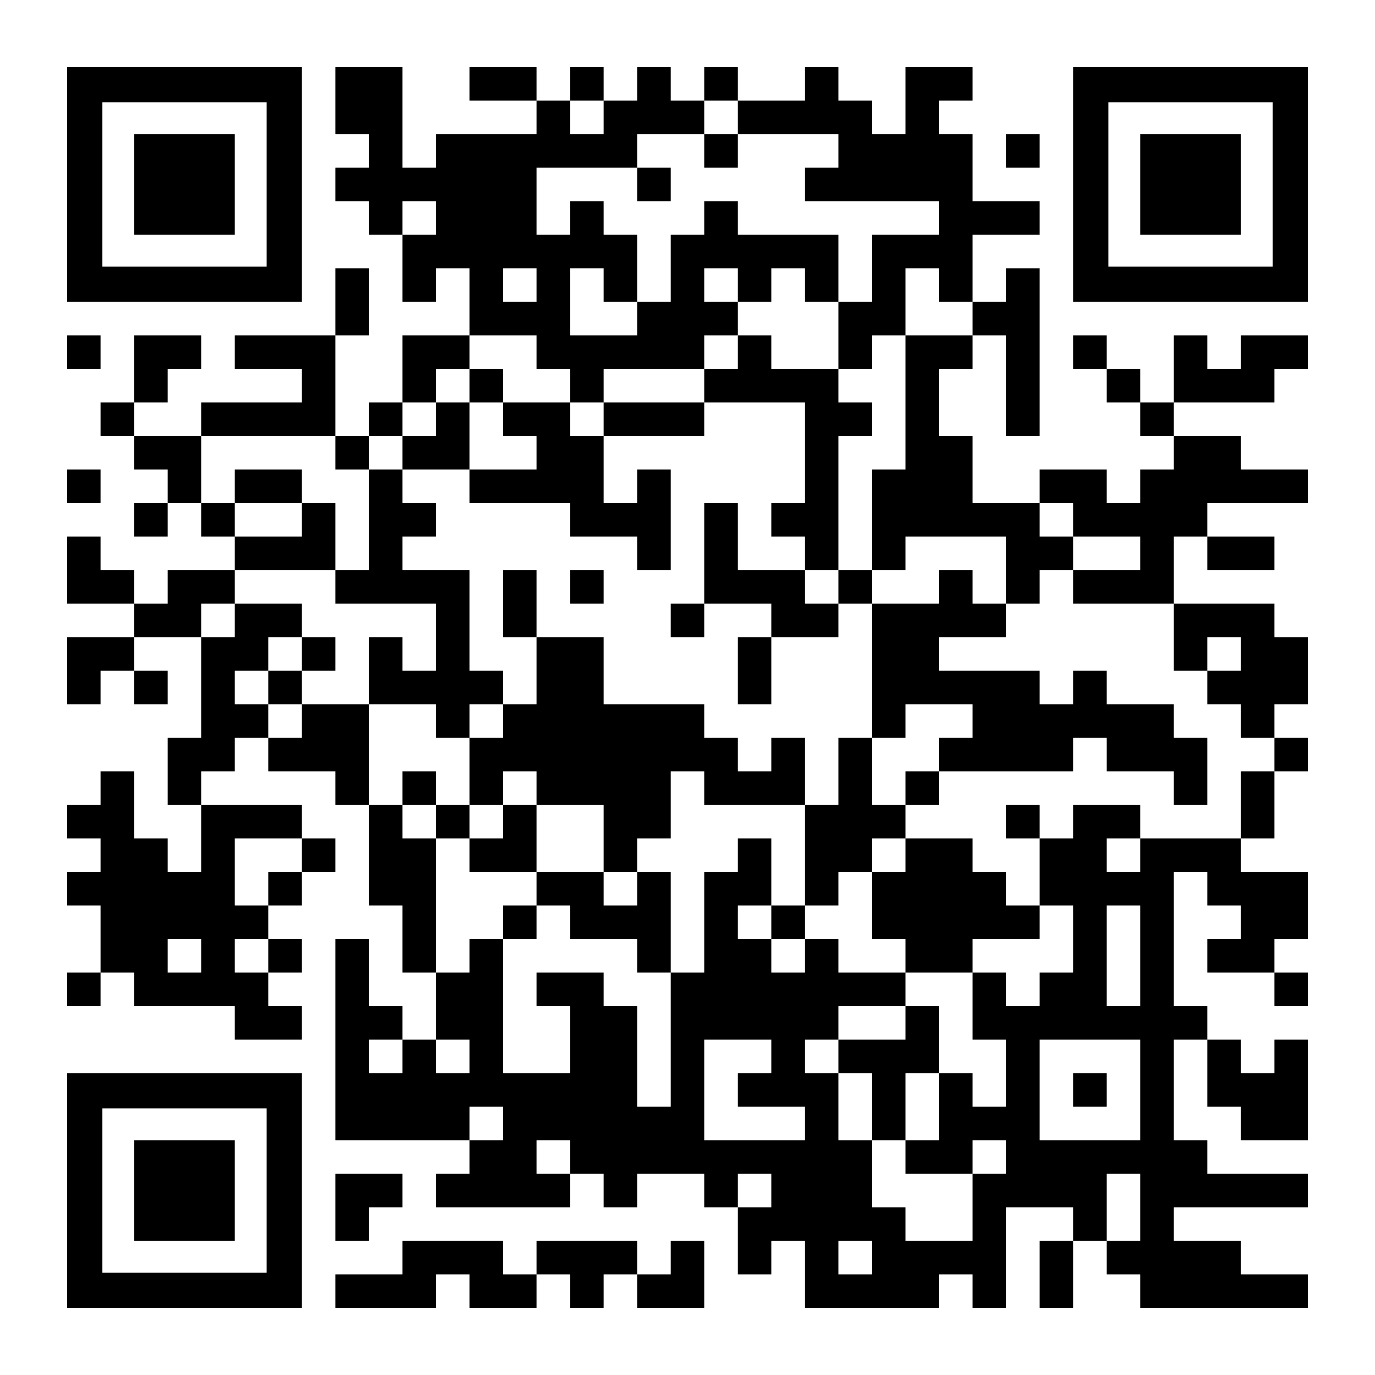
DOWNLOAD THE APP ON YOUR PHONE
We employ our mobile phone's camera to scan the QR code below
The specific QR code leads the user to a Google Drive where the APK file of the application is located.

Slide 23
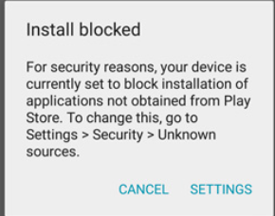
DOWNLOAD THE APP ON YOUR PHONE
After you follow the link and find yourself inside the Drive with the APK file, select it. Before the download starts, a pop-up window will appear on your screen, instructing you to grant permission to the Google Drive application to download files. Follow the steps indicated by your mobile device, and the application will be ready to download.
Μore specifically:
Navigate to Setting > Security.
Check the option “Unknown sources“.
Tap OK on the prompt message.
Select “Trust“.

Slide 24
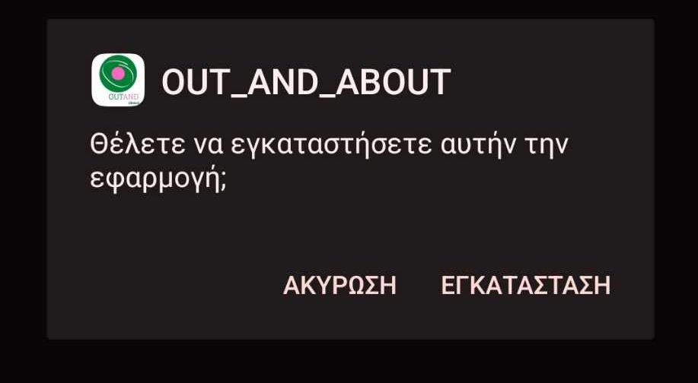
DOWNLOAD THE APP ON YOUR PHONE
After the download is complete, you will encounter this screen. Click "Install," and in approximately a minute, you will be able to locate the app in your app menu.

Slide 25

HOW TO USE THE APP
Browse your app menu to locate the specified image, then click on it to open the app.

Slide 26

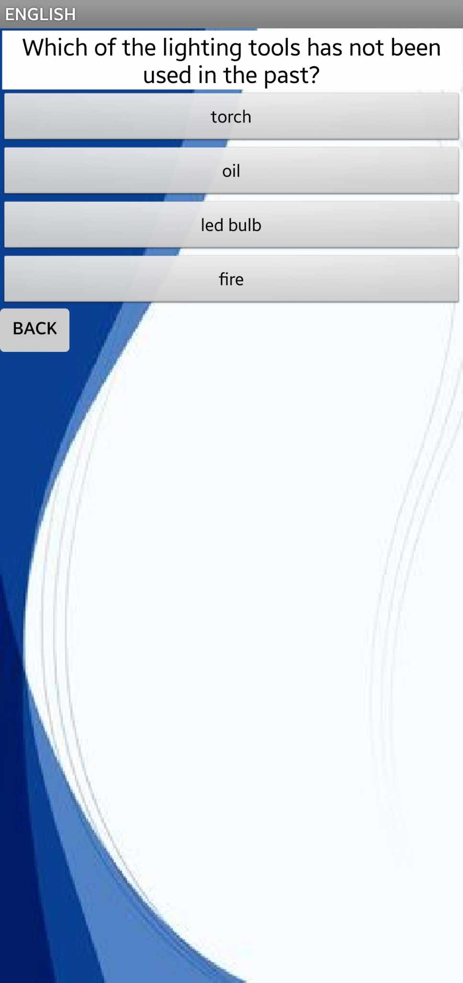
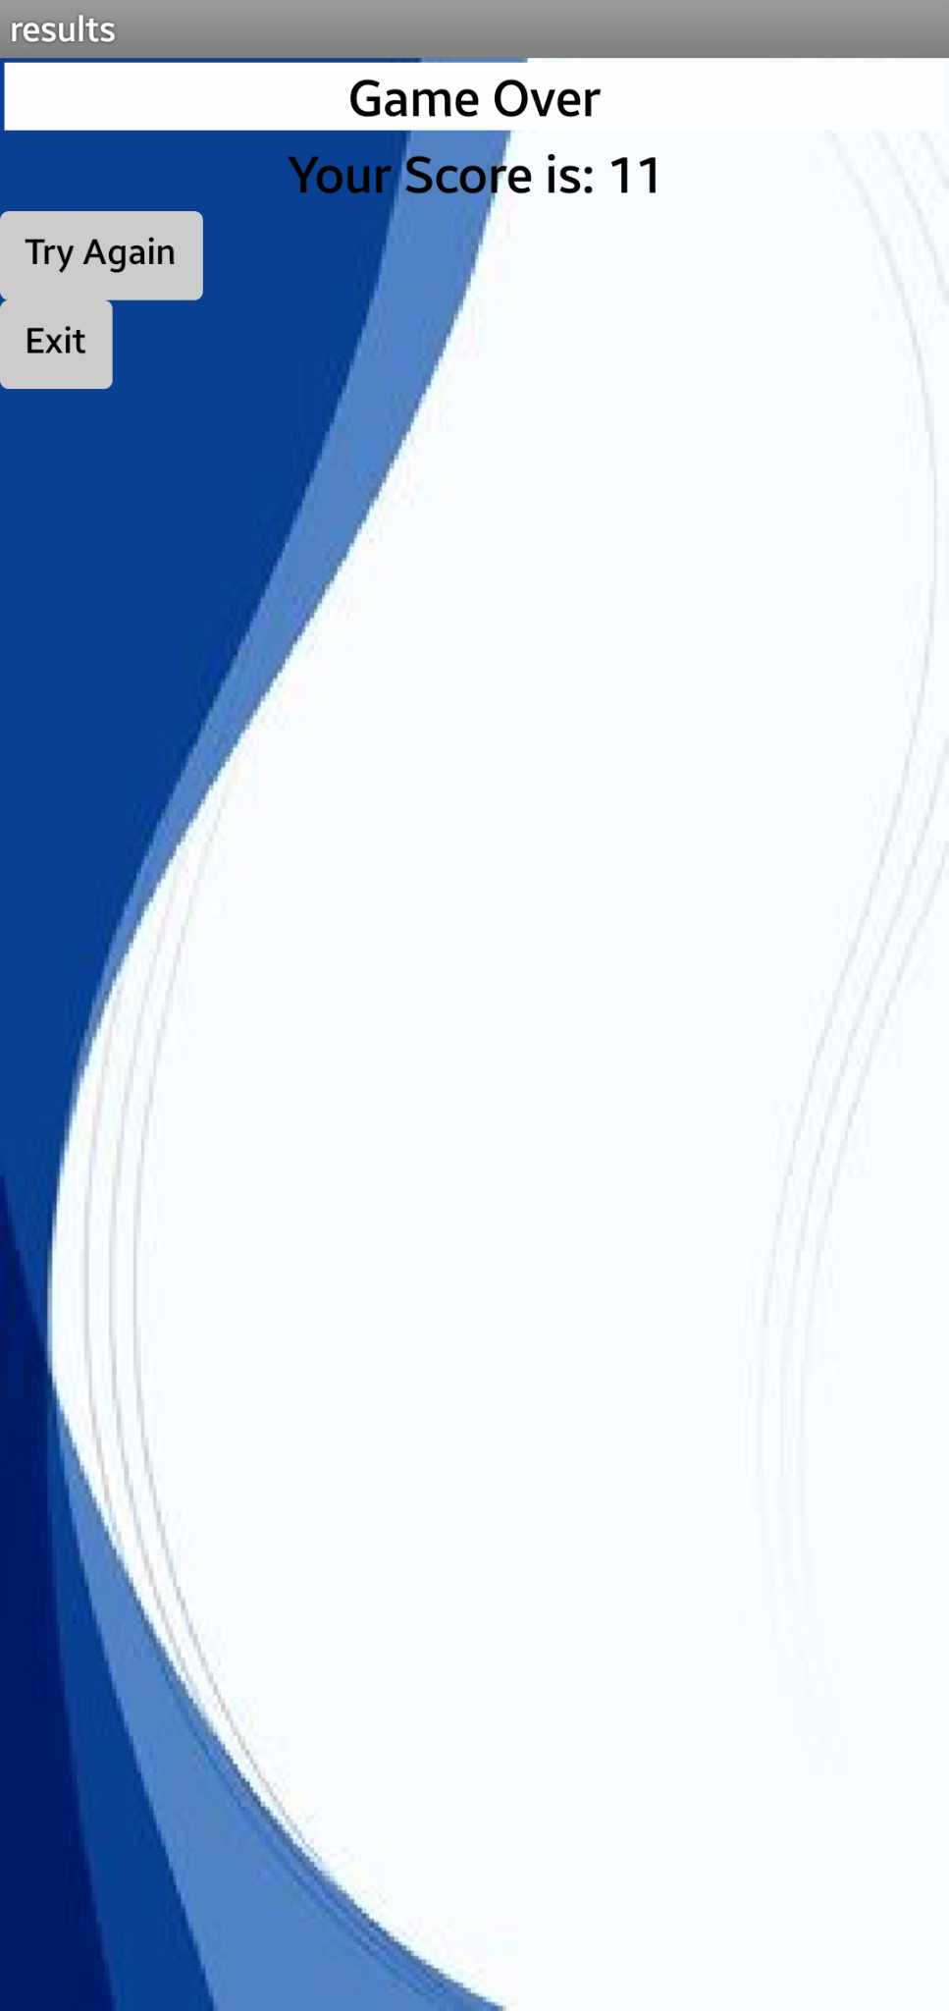
WE ARE READY
Now you are all set to enjoy the quiz and aim to surpass your friends' high scores.

